Slide 1
Words as numbers: bag of words, TF-IDF, embeddings and distance
How can a computer find the right clause or policy when I describe it in plain words?
Applied AI and Automation | Session 4 of 14
KLAi Professional Learning | Jotham Martin Wambi
Notes:
Last time you measured a model with a confusion matrix and a threshold, and every example was a table of numbers. Most business data is words, and a computer only handles numbers. Today text becomes numbers too. We start with an everyday example, three friends rating two films, to meet vectors and four ways of measuring how close two of them are.
Then the same ideas apply to text: from a simple word count to the embeddings behind search by meaning. You work the measures out by hand.

Slide 2



Today in one view: what you will leave with
By the end of today you will have
See how a message becomes a vector: word counts, TF-IDF weights and embeddings
Work out four measures by hand (Euclidean distance, Manhattan distance, dot product, cosine similarity) and say when each one fits
Take away a cheat sheet of the four measures, and know where semantic search helps or hurts your work
Notes:
To answer that question, today has three parts. You will see how a message becomes a vector: first as word counts, then as TF-IDF weights, then as an embedding. You will work out four measures by hand with a pencil: Euclidean distance, Manhattan distance, the dot product and cosine similarity.
And you leave with a cheat sheet of the four. You will also decide where semantic search could help or hurt in your own work.

Slide 3
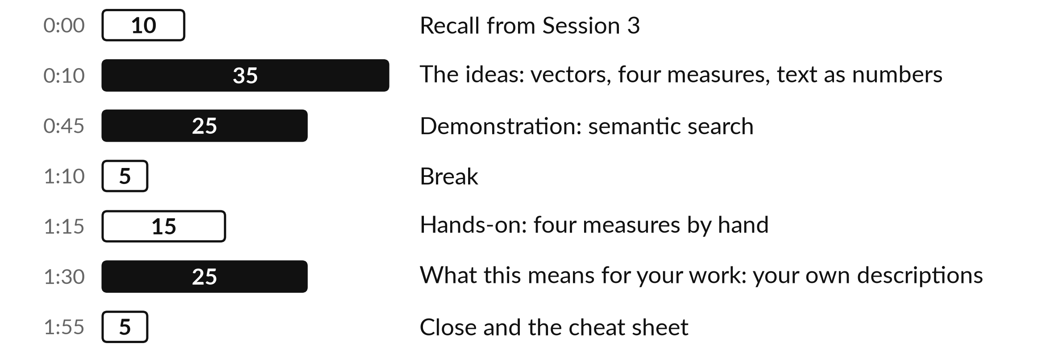
Your two hours: from film ratings to a
search that understands a description
The search results are recorded in advance. You can ask me to run any description of yours live.
Notes:
Here is how we get there. We start with something everyone knows, three friends rating two films, and see that a list of numbers is a vector. We work out the four standard ways of measuring how close two vectors are: Euclidean distance, Manhattan distance, the dot product and cosine similarity.
Then we turn text into vectors, in three steps, from a simple word count to an embedding. I run a live semantic search where a plain description finds the formal clause, term or policy, on three kinds of text. After the break you work the four measures out by hand on paper.
We finish with your own descriptions, and where this helps or hurts in your work.

Slide 4

Three questions from last time
1. Why can accuracy mislead when the thing you look for is rare?
2. What do precision and recall each ask?
3. What happens when you lower the threshold?
Answer aloud first. Then we check together.
Notes:
Three quick questions from Session 3. Answer aloud first, and then we check together. It is a warm-up to bring last time back.
Question one. Why can accuracy mislead when the thing you look for is rare? Take a moment.
A good answer is this. A model that always predicts the majority class scores very high and catches nothing. In our run, always saying on time scored 90.8 percent. Ask for the baseline, precision and recall.
Question two. What do precision and recall each ask? Say it to yourself first.
A good answer is this. Precision: of the cases flagged, how many were real, TP divided by TP plus FP. Recall: of the real cases, how many were flagged, TP divided by TP plus FN.
Question three. What happens when you lower the threshold? Think about your own work as you answer.
A good answer is this. The model flags more cases. It catches more real ones (true positives) and also raises more false positives.
If an answer was missing, last session’s take-away sheet or workbook page has it. Now to today.

Slide 5
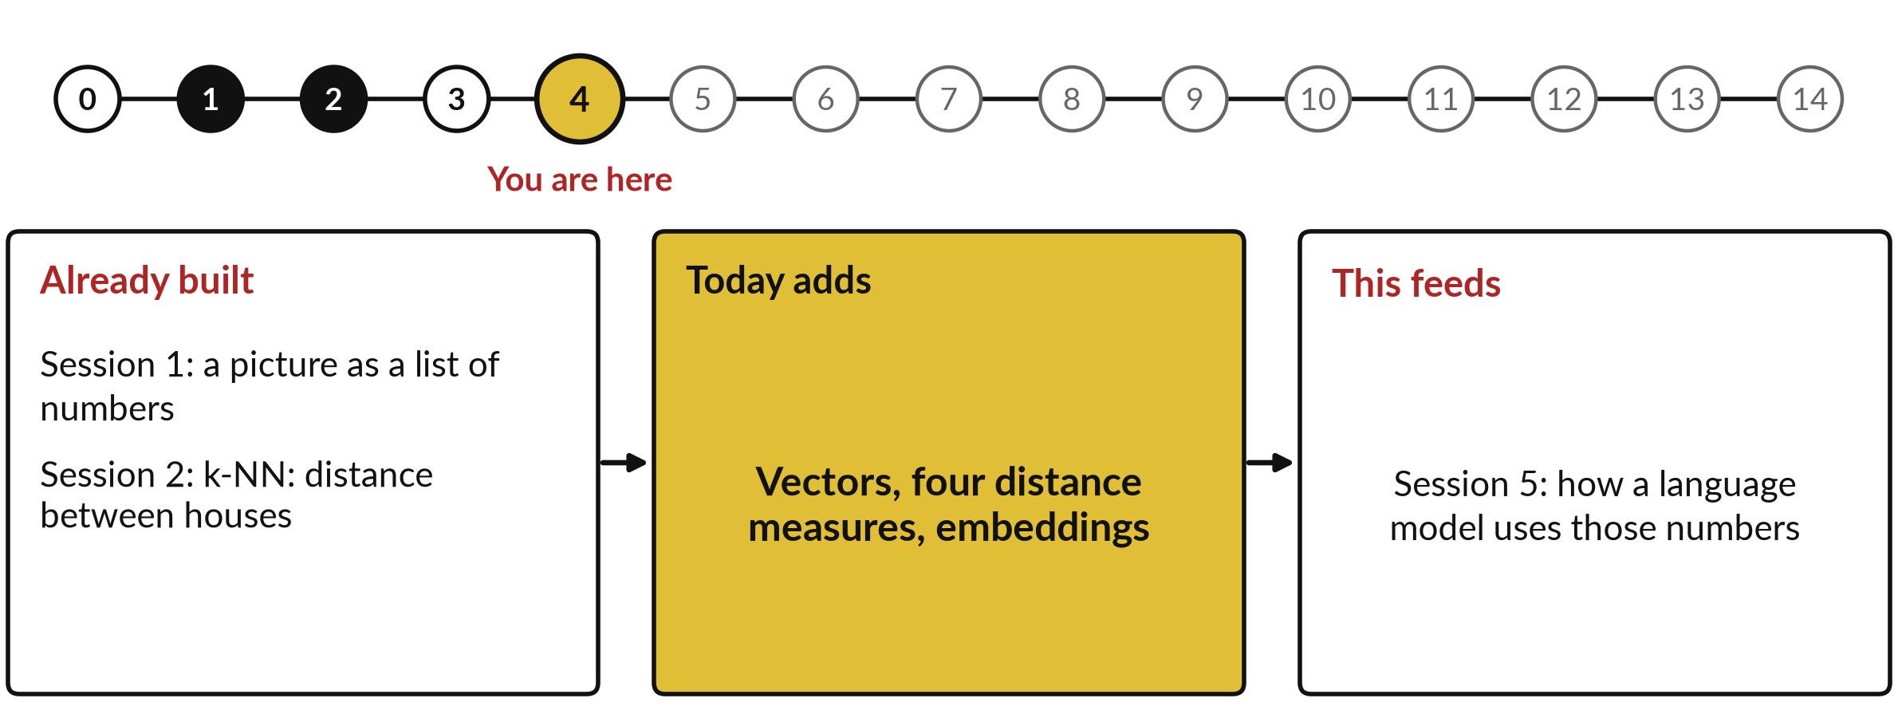
How today connects: what we
already have and what it feeds
Each session is built on the ones before it.
Notes:
So where does today sit in the story? The dots along the top are the fifteen sessions, from the map at Session 0 to your plan at Session 14, and the gold one is today.
We already hold a picture as a list of numbers from Session 1 and k-NN: distance between houses from Session 2. Nothing today starts from zero.
What today adds is this: vectors, four distance measures, embeddings.
And it feeds straight into what comes next. Session 5: how a language model uses those numbers. Keep that chain in mind, because each idea you learn today is a step on it.

Slide 6






Words we use today
Word | What it means
Vector | A list of numbers, such as Ana's two film ratings (3, 4). Each position is a dimension.
Bag of words | A message as a vector of word counts. The word order is lost.
TF-IDF | Term frequency times inverse document frequency: a count in which rare terms weigh more than common ones.
Embedding | A vector of numbers, produced by a trained model, that represents the meaning of a text.
Euclidean and Manhattan distance | Two ways to measure the gap between vectors. Smaller means closer.
Dot product and cosine similarity | Two ways to measure agreement between vectors. Bigger means closer.
Notes:
6 words for today. I give the plain meaning of each, and we use every one of them before the end of the session.
Vector. A list of numbers, such as Ana's two film ratings (3, 4). Each position is a dimension.
Bag of words. A message as a vector of word counts. The word order is lost.
TF-IDF. Term frequency times inverse document frequency: a count in which rare terms weigh more than common ones.
Embedding. A vector of numbers, produced by a trained model, that represents the meaning of a text.
Euclidean and Manhattan distance. Two ways to measure the gap between vectors. Smaller means closer.
Dot product and cosine similarity. Two ways to measure agreement between vectors. Bigger means closer.
Keep those words close. The first idea uses them straight away, so let us begin.

Slide 7
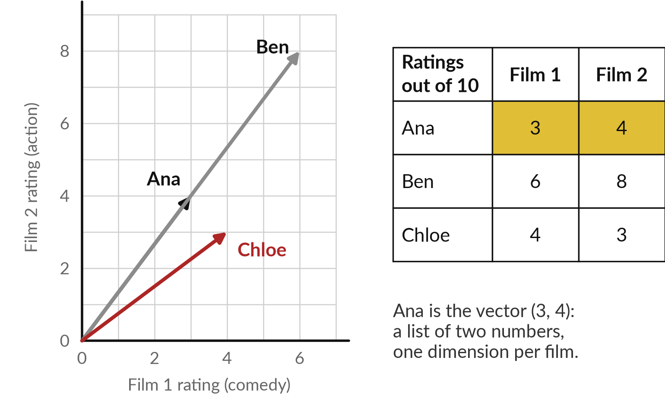
A vector is a list of numbers: three
friends rate two films out of 10
Ana, Ben and Chloe rate Film 1 (a comedy) and Film 2 (an action film).
Ana is the vector (3, 4).
Each film is one dimension.
Ben rates higher but likes the same mix as Ana.
Who has a taste closest to Ana?
Notes:
We start with something everyone knows: film tastes. Three friends rate two films out of ten. Ana gives the comedy a three and the action film a four. Ben gives six and eight. Chloe gives four and three. Each person is now a list of two numbers, and a list of numbers is called a vector.
Each position in the list is a dimension, so these are two-dimensional vectors, and we can draw each as an arrow from zero on squared paper. The question is: who has a taste closest to Ana?
Ben rates everything higher, Chloe leans the other way. There is more than one sensible way to measure closeness, and today we learn four.

Slide 8
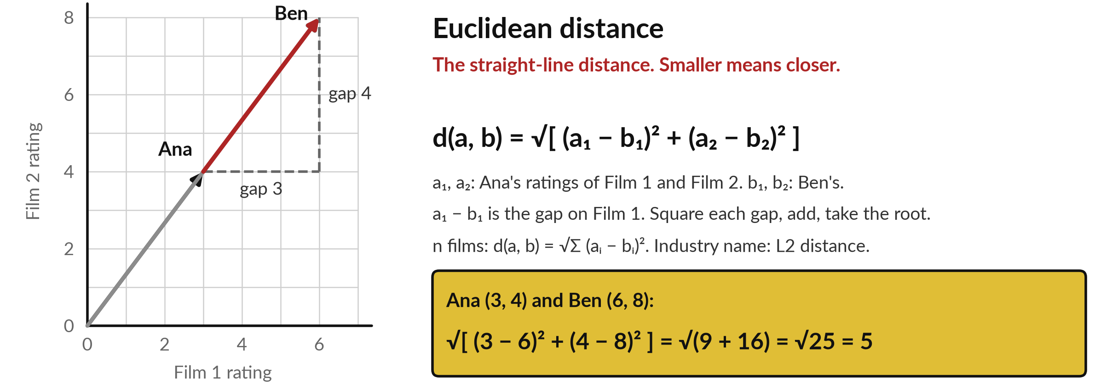
Euclidean distance is the straight-line
gap between two vectors
Ana and Ben rate two films out of 10. Gold: the worked answer.
Notes:
The first measure is the one a ruler gives you: the straight-line gap between the tips of two arrows. Its name is Euclidean distance, after the Greek geometer, and in industry you will hear L2 distance. The formula is on the slide. Say it aloud: d of a and b equals the square root of the sum of a i minus b i, all squared.
Here a1 and a2 are Ana's ratings of Film 1 and Film 2, and b1 and b2 are Ben's. Take the gap on each film, three and four. Square each gap, nine and sixteen, add them to get twenty-five, and take the square root, five. The same recipe works for a list of any length. Smaller means closer. Zero would mean identical tastes.

Slide 9
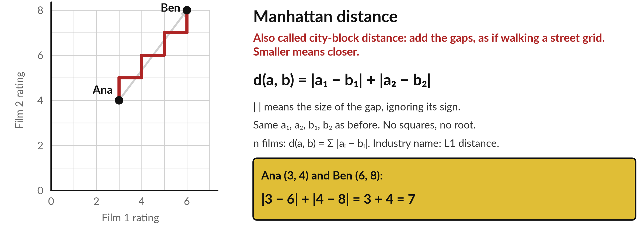
Manhattan distance adds the gaps along each axis
Also called city-block distance. The red path walks the grid: 3 across, 4 up.
Notes:
The second measure adds the gaps instead of squaring them. It is called Manhattan distance, also city-block distance, and in industry L1 distance, because it is the length of a walk along a street grid with no shortcuts through buildings. As a memory aid, think of walking three blocks across and four blocks up.
Where the analogy breaks: the real formula works for any number of dimensions, however many streets that takes. In words: the sum of the absolute gaps. The vertical bars mean the size of the gap with the sign ignored. For Ana and Ben the gaps are three and four, so the total is seven.
The straight line was five, and the grid walk is seven. Smaller means closer.

Slide 10
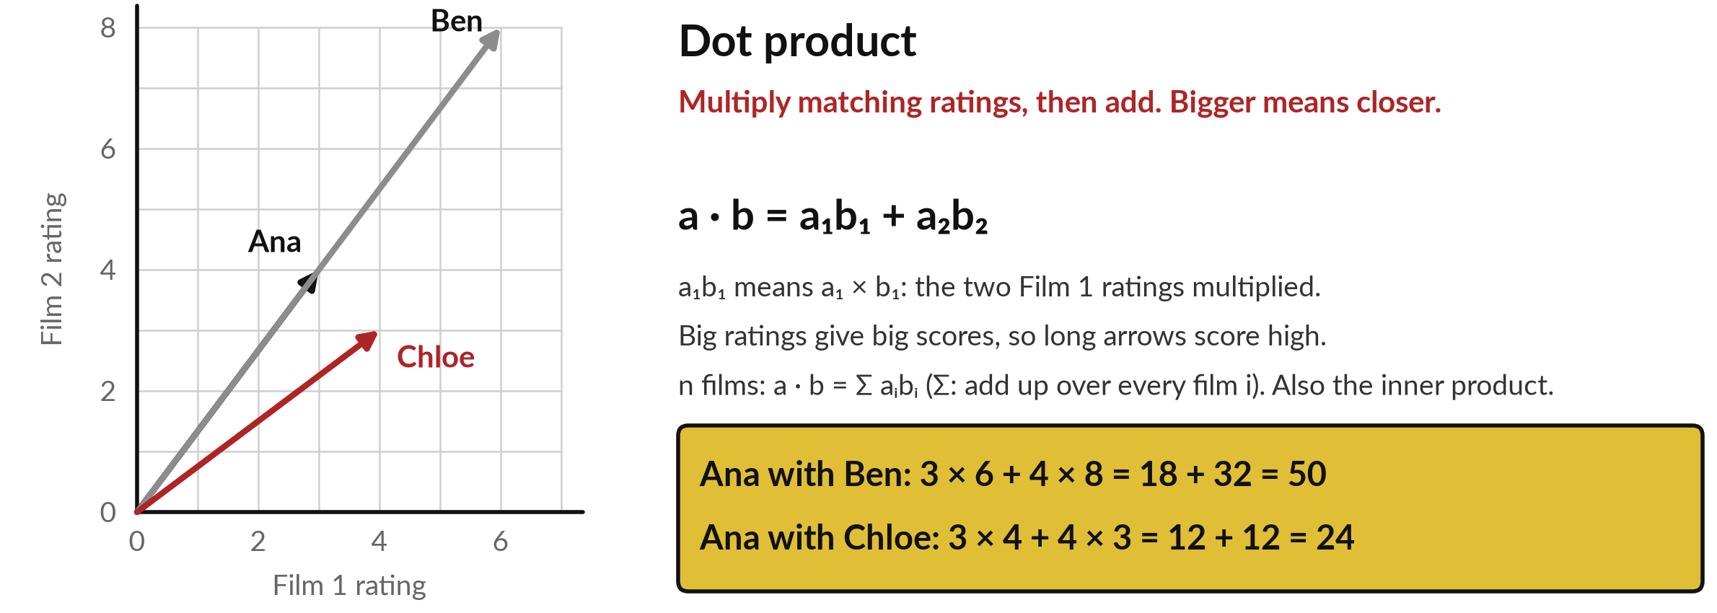
The dot product multiplies
matching ratings and adds them
A bigger score means closer. Ben scores higher than Chloe, partly because Ben's arrow is long.
Notes:
The third measure asks how much two vectors agree, instead of how far apart they are. It is the dot product. Multiply the two Film 1 ratings together, multiply the two Film 2 ratings together, and add. Ana with Ben: three times six is eighteen, four times eight is thirty-two, total fifty.
Ana with Chloe: three times four is twelve, four times three is twelve, total twenty-four. The formula in words: the sum of a i times b i. The symbol a1 next to b1 means a one times b one. Industry also calls it the inner product. Here bigger means closer.
But look at a weakness. Ben rates everything high, so Ben's arrow is long, and long arrows pick up big scores just for being long.

Slide 11
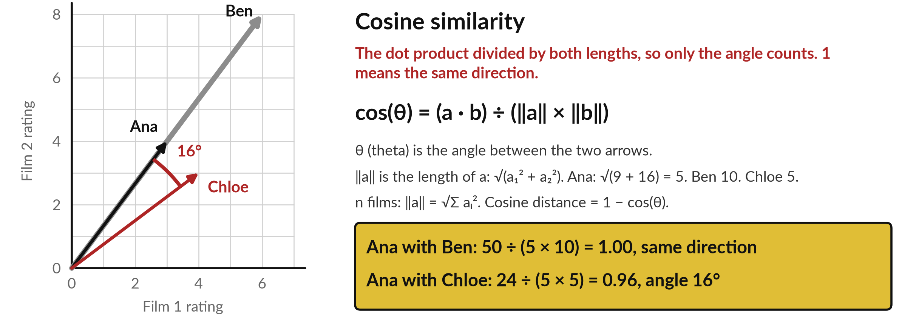
Cosine similarity compares only
the angle between two vectors
Ben points exactly the same way as Ana. Chloe is 16 degrees away.
Notes:
The fourth measure fixes the length problem by looking only at the angle. Cosine similarity is the dot product divided by the two lengths multiplied together. The length of an arrow is the square root of its squared ratings added. Ana is the square root of nine plus sixteen, which is five.
Ben is ten, and Chloe is five. Ana with Ben: fifty divided by five times ten is one. No angle at all, same direction. Ana with Chloe: twenty-four divided by twenty-five is zero point nine six, sixteen degrees apart. One means the same direction, zero means a right angle.
Cosine ignores length, and for text that is usually what we want. Industry also uses cosine distance, which is one minus the cosine similarity.

Slide 12
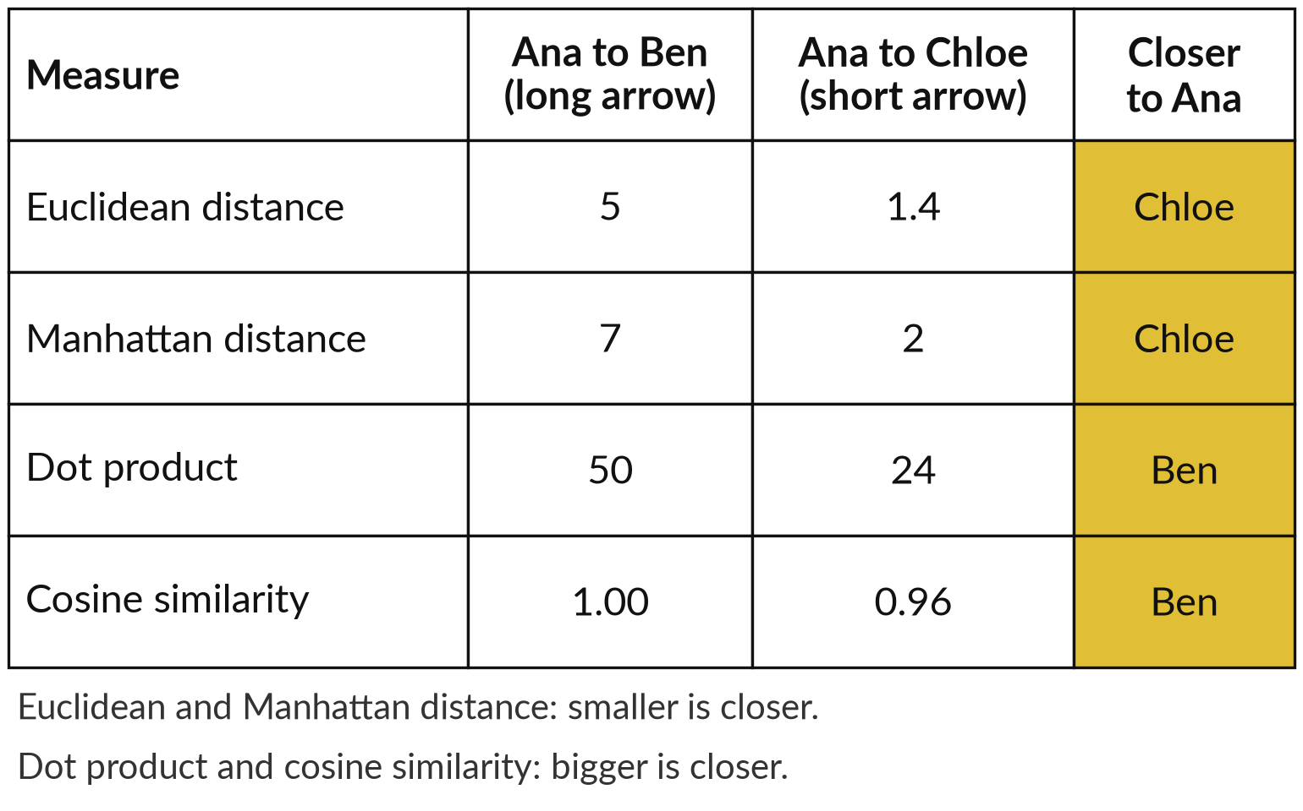
The four measures can pick different
winners, so know which one you use
Who is closer to Ana: Ben, the enthusiast, or Chloe?
Euclidean and Manhattan pick Chloe.
Dot product and cosine pick Ben.
Cosine is widely used for text, because length says little about meaning.
Notes:
You now have four measures, so let me put all four on one question. Who is closer to Ana: Ben, whose arrow is long, or Chloe, whose arrow is short?
Euclidean distance says Chloe, one point four against five. Manhattan distance says Chloe, two against seven. The dot product says Ben, fifty against twenty-four, because Ben's arrow is long. Cosine similarity says Ben, one against zero point nine six, because Ben points exactly the same way as Ana.
They disagree, and none of them is wrong. They measure different things. For text, cosine is widely used, because the length of a passage tells you little about its meaning. When a vendor says similarity, ask which measure.

Slide 13
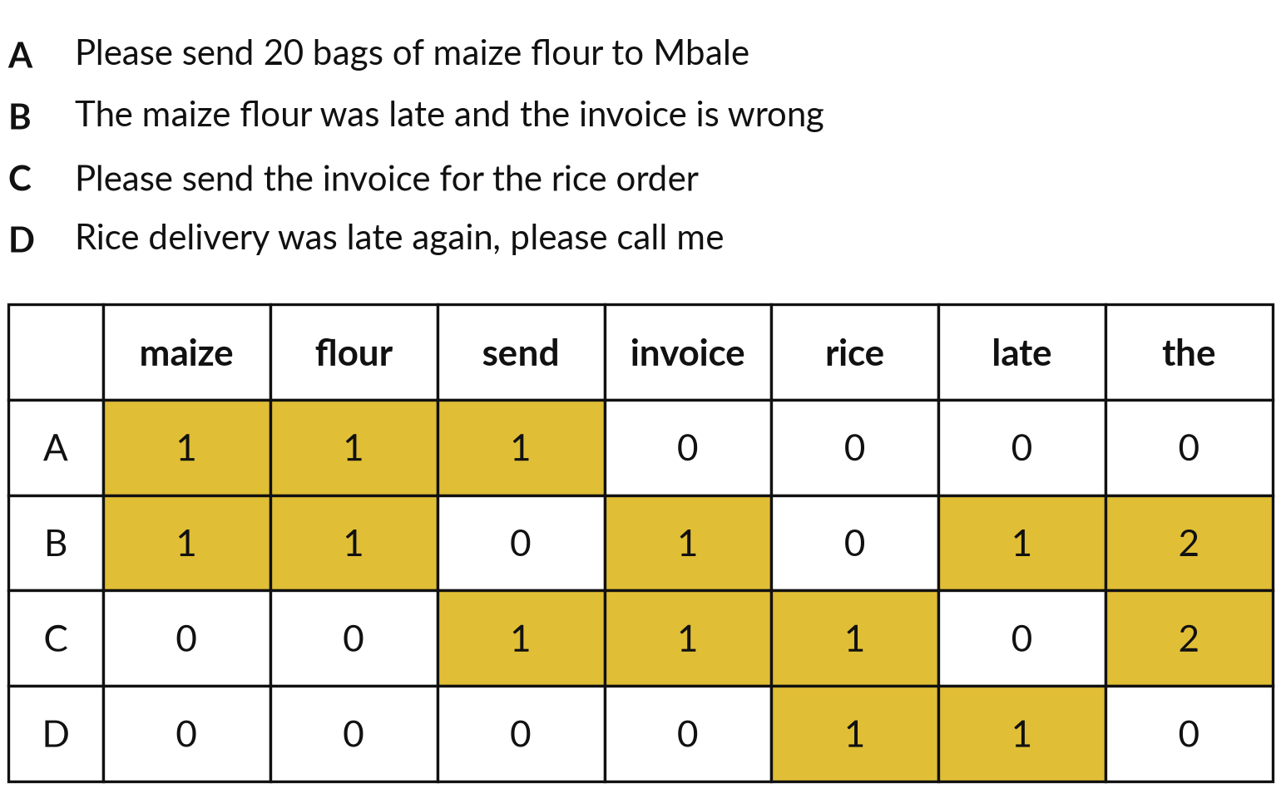
A bag of words turns a message
into a vector of word counts
Like counting ingredients in a recipe: two eggs, one cup of flour. Here we count words.
Message B has "the" twice and "late" once.
Order is lost: "man bites dog" equals "dog bites man".
Problem: "the" counts like "invoice".
Notes:
Now the same idea for text. A customer message is a short text, such as an order or a complaint, and we want the machine to compare messages. The simplest way to give a message numbers is to count words, much as a recipe counts ingredients. Here are four short invented messages.
For each we count how often a few words appear. Message B has the word the twice and the word late once. Each message becomes a row of numbers, a vector with one dimension per word. This is called a bag of words, because the words are shaken into a bag and the order is lost.
It is crude but useful. It treats every word as equally important, and that is the problem the next step fixes.

Slide 14
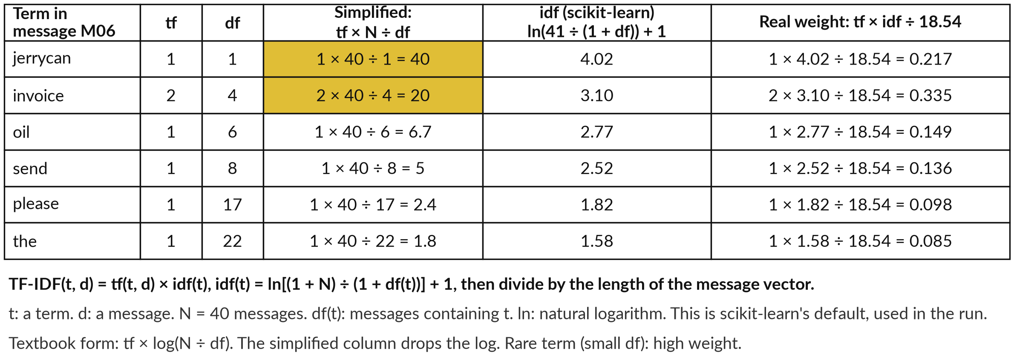
TF-IDF gives rare terms more weight,
because a rare term points to its message
Recorded run, 6 Nov 2026: message M06 of 40 invented messages. Real: scikit-learn defaults.
Notes:
That equal treatment is the weakness. TF-IDF stands for term frequency times inverse document frequency. Term frequency, tf, is how often a term appears in the message. Document frequency, df, is how many of the forty messages contain it. A term in few messages says more about its message than a term found everywhere.
The simplified column, in gold, multiplies tf by forty divided by df: invoice appears twice and is in four messages, so two times ten is twenty. The recorded run used the scikit-learn default form. The idf is the natural log of forty-one over one plus df, plus one.
The weight is tf times idf, divided by the length of the message vector. For invoice: two times 3.10, divided by 18.54, is 0.335. Weighting still cannot see meaning.

Slide 15
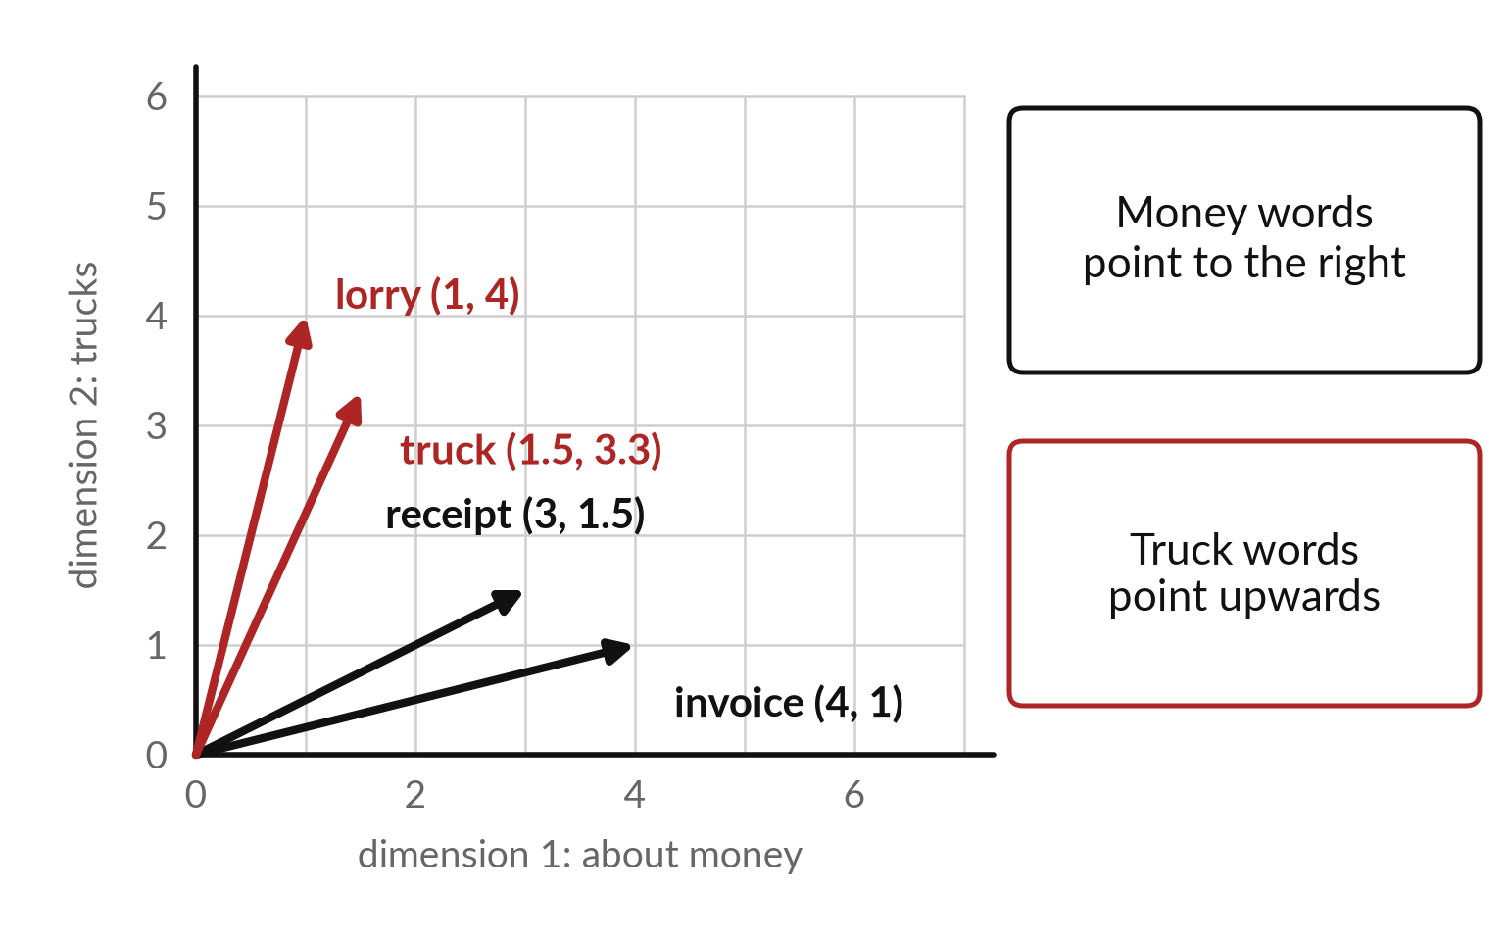
An embedding is a vector that places a text
so that similar meanings sit close together
A toy with two dimensions: how much a word is about money, and about trucks.
invoice (4, 1): mostly money.
lorry (1, 4): mostly trucks.
Close arrows mean close meaning.
Real embeddings have hundreds of dimensions.
Notes:
Weighting helps, but it still cannot see meaning. The words flood and force majeure share no words, yet they are close in meaning. An embedding fixes that. It is a vector, like Ana's ratings, but its numbers describe meaning. Here is a toy with two dimensions that I chose myself: how much a word is about money, and how much about trucks.
Invoice and receipt point to the right. Lorry and truck point upwards. Close arrows mean close meaning. This is a vector space, and we can measure closeness in it with the four measures. In a real embedding nobody names the dimensions. A trained model learns hundreds of them.
Who chooses those numbers, though?

Slide 16
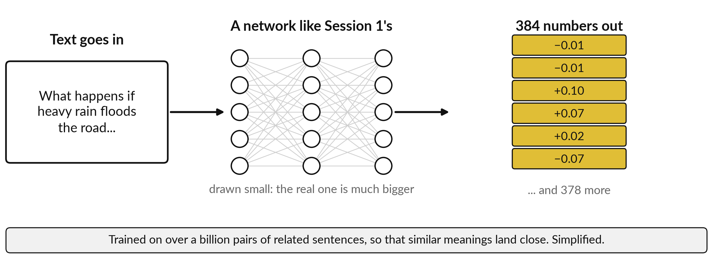
A network produces the vector, trained
so that similar meanings land close
Simplified. The model is all-MiniLM-L6-v2: text in, 384 numbers out.
Notes:
A fair question is who chooses the numbers. Nobody does by hand. A neural network reads the text and produces them, much like the digit network of Session 1, which read 64 numbers and produced 10 scores. Here the text goes in, and 384 numbers come out. It is trained on a very large set of examples, over a billion pairs of related sentences for this model, so that texts with similar meaning end up with similar vectors.
That is a simplified account, and the picture draws the network small. The result is the vector space from the last slide, with 384 dimensions instead of two. So the numbers are learned, not written by a person. Now let us look at some real ones.

Slide 17
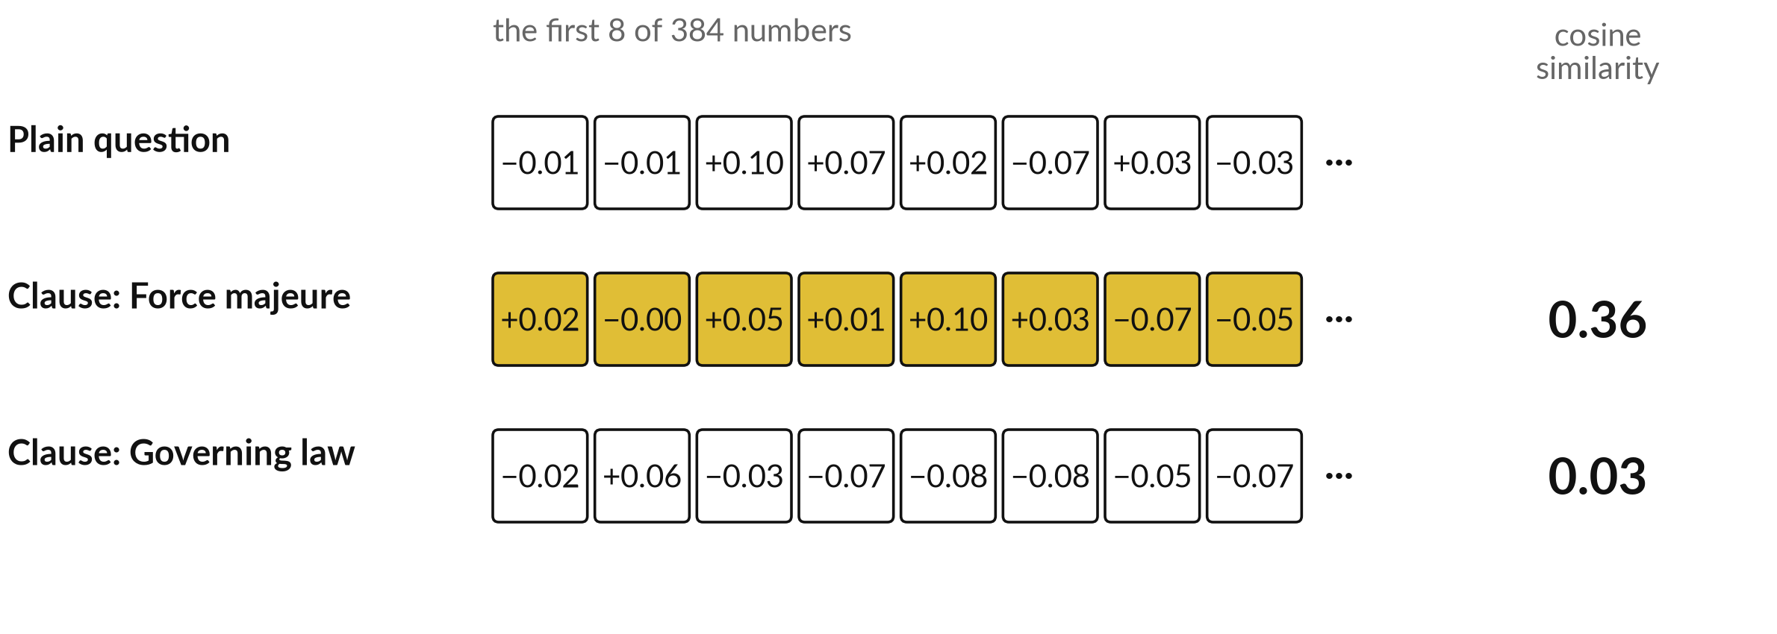
A real embedding has 384 numbers:
nobody reads them, we compare them
Recorded run, 6 Nov 2026, model all-MiniLM-L6-v2. Gold: close in meaning.
Notes:
Two numbers is a toy, so here is a real embedding from a recorded run. I used the small open model you just saw, all-MiniLM-L6-v2, whose model card says it turns a sentence into a vector of three hundred and eighty-four numbers. Here are the first eight numbers for three texts.
The first is a plain question about heavy rain flooding the road. The second is the force majeure clause, which is about events beyond anyone's control. The third is the governing law clause. The model produced them. No person can read them. We only compare them, with a measure like the ones we just worked, here cosine similarity.
The question and the force majeure clause score zero point three six. The governing law clause scores zero point zero three.

Slide 18
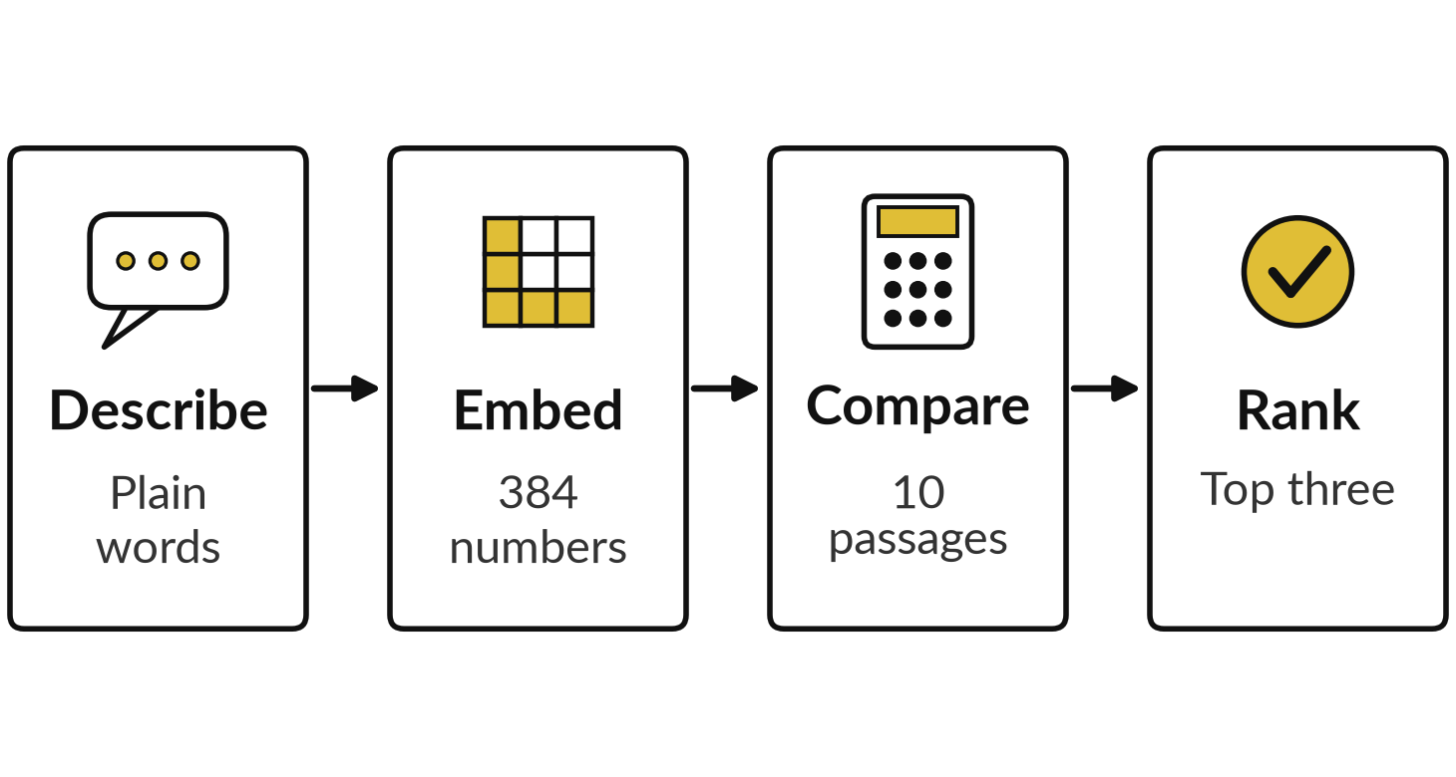
Demonstration: describe a clause in
plain words and find its formal name
I will show
Watch for
The right term in the top three.
A keyword search that finds nothing.
Compare scores only within one search.
Notes:
All four measures work on any vectors, so let me use them on real text. I type a plain description, and the computer returns the formal clause, term or paragraph that matches. This is called semantic search. Four steps. I describe it in plain words. The model turns my description into three hundred and eighty-four numbers.
It compares those numbers with the numbers of ten passages, using cosine similarity. And it ranks them, showing the top three. Next to it I show a keyword search, which looks only for shared words. You choose the kind of text: contract clauses, finance terms or HR policy paragraphs.
Watch for the right answer in the top three, and for the keyword search finding nothing at all.

Slide 19
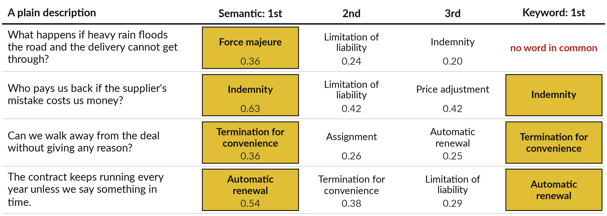
Contract clauses: the right clause came
first for all four plain descriptions
Recorded run, 6 Nov 2026. Gold: the right clause. Scores: cosine similarity.
Notes:
What did you see? The right answer near the top, and a keyword search that found little or nothing. That is semantic search at work. Here are the recorded results for contract clauses. On the left, four descriptions in plain words. What happens if heavy rain floods the road and the delivery cannot get through?
The model puts force majeure first, at zero point three six. Who pays us back if the supplier mistake costs us money?
Indemnity, first. Can we walk away without giving a reason?
Termination for convenience. The contract keeps running every year unless we say something in time?
Automatic renewal. In the last column, a keyword search finds the right clause for three of the four, and for the flood question no clause shares a single word with the description.

Slide 20
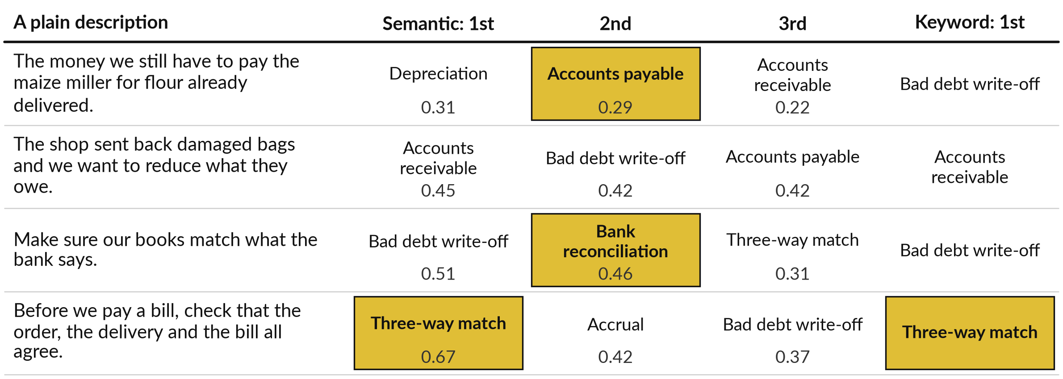
Finance terms: first once, in the top three
for three of four, so a person still chooses
Recorded run, 6 Nov 2026. The right term was fourth for the second description.
Notes:
Clean results like that can mislead, so here is the same run on finance and invoice terms. This one is messier, and I show it on purpose. For the money we owe the maize miller, the right term, accounts payable, came second behind depreciation. For three-way match, the right term came first.
For make sure our books match what the bank says, bank reconciliation came second, behind bad debt write-off. And for the shop that sent back damaged bags, the right term, credit note, came fourth, behind accounts receivable. That is a reasonable answer to the question, because the shop does owe us money. Semantic search gives a shortlist, and a person picks from it.

Slide 21
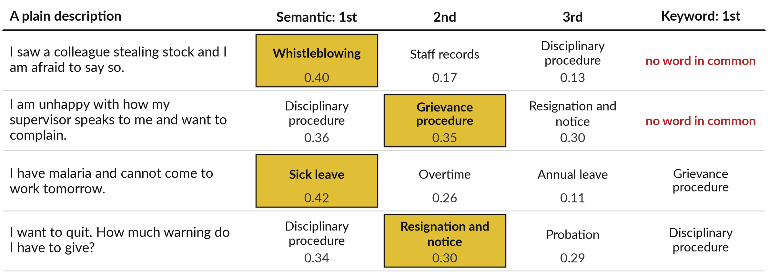
HR policy: the right paragraph was in the top three
for all four, and keyword search found none first
All 12 searches: right answer first 7, in the top three 11; keyword search first 4.
Notes:
That shortlist idea holds for the third kind of text, HR policy paragraphs. The person afraid to report a colleague who steals stock gets whistleblowing, first. The malaria message gets sick leave, first. The unhappy employee who wants to complain gets the disciplinary procedure first and the grievance procedure second.
The person who wants to quit gets the notice paragraph second. In all four the right paragraph is in the top three, and the keyword search never puts the right one first. Over all twelve searches: semantic search had the right answer first in seven and in the top three in eleven. Keyword search had it first in four.

Slide 22
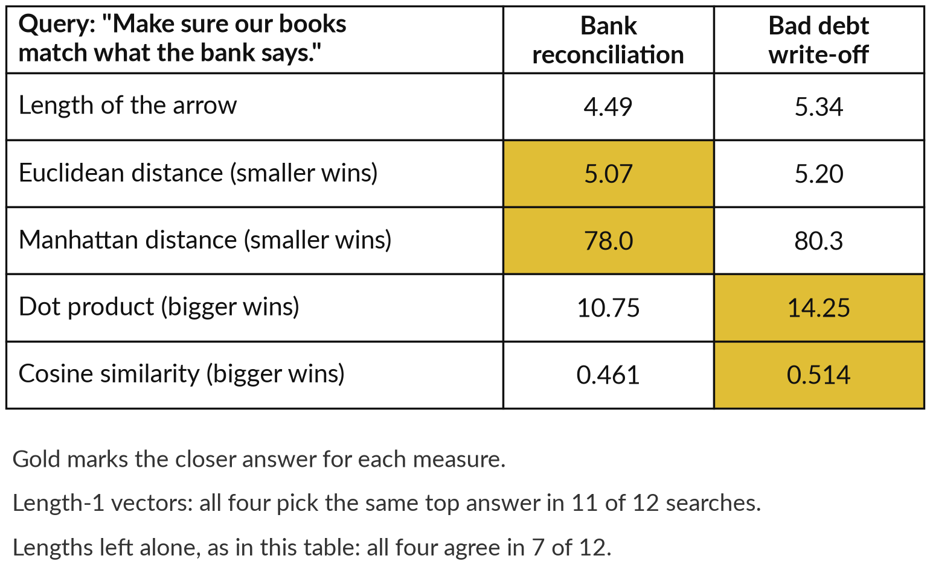
The four measures agree when vectors have
equal length, and part ways when they do not
This model sets every vector to length 1 as a last step. Skip it and the measures split.
Same question, lengths left alone: Euclidean distance says bank reconciliation.
Dot product and cosine say bad debt write-off.
No measure is right every time.
Notes:
All that ranking used cosine similarity, so you may ask whether another measure would change the winner. Mostly it would not, and here is why. By default this model scales every vector to exactly length one as its last step. With equal lengths, Euclidean distance, the dot product and cosine similarity always give the same order, and Manhattan distance usually.
In our twelve searches all four agreed on the top answer in eleven. I can skip that last step and leave the lengths alone. Then they split. For the question about matching our books to the bank, the two candidate vectors have lengths four point five and five point three.
Euclidean and Manhattan distance pick bank reconciliation, the right one. The dot product and cosine pick bad debt write-off. Check the top three, whichever measure you use.

Slide 23
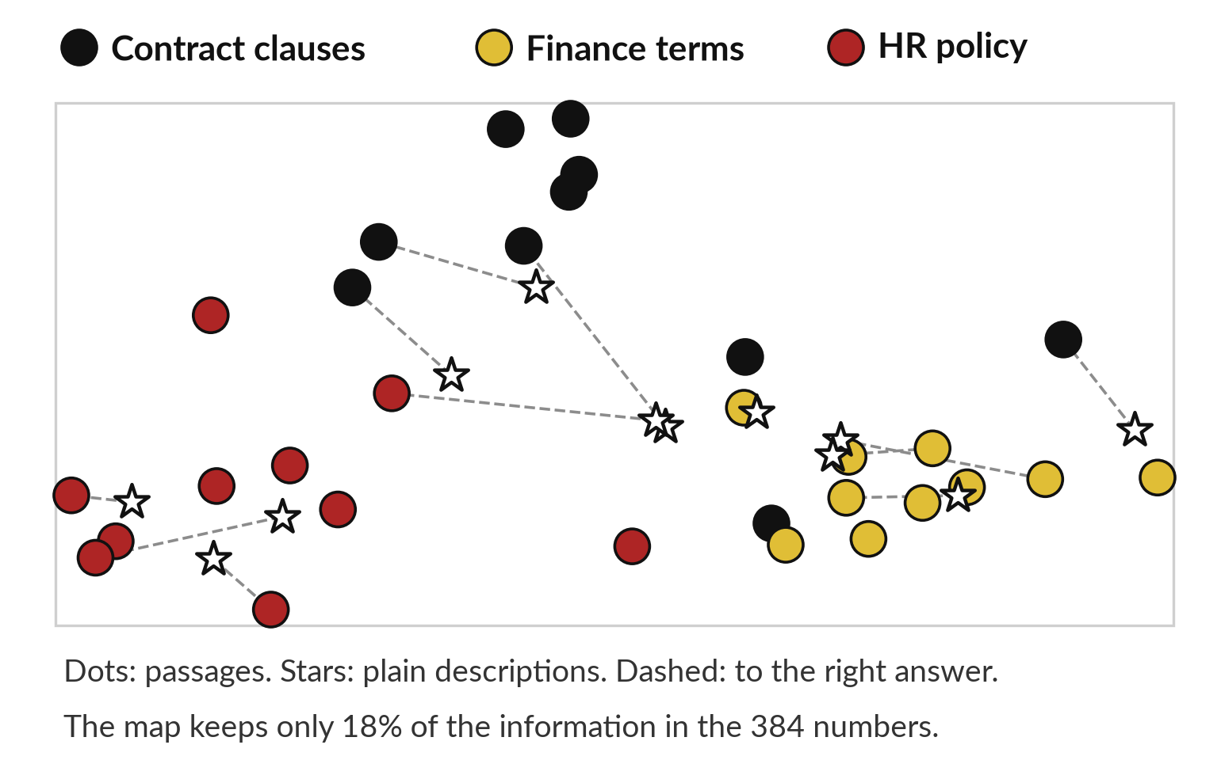
A 2D map of the embeddings shows the clusters,
but keeps only 18 percent of the information
Reduce 384 dimensions to 2 and similar texts still sit together.
Three clusters: contracts, finance, HR.
A description can sit far from its answer on the map.
The method is PCA, principal component analysis.
Notes:
Everything so far has been vectors and tables, so can we see all this?
Not in three hundred and eighty-four dimensions, so we reduce them to two. This is a real map of the thirty passages and twelve descriptions from today. A method called PCA, principal component analysis, keeps the two directions in which the points differ most. Another method is t-SNE.
Contract clauses cluster at the top, finance terms on the right, HR paragraphs on the left. Price adjustment, a contract clause, sits near the finance terms, which makes sense. But look at what the map loses. It keeps only eighteen percent of the variation in the numbers, a rough measure of the information.
A description can sit far from its answer on the map, even though in the full vectors it is close. Use a map to see clusters, never to measure distances.

Slide 24
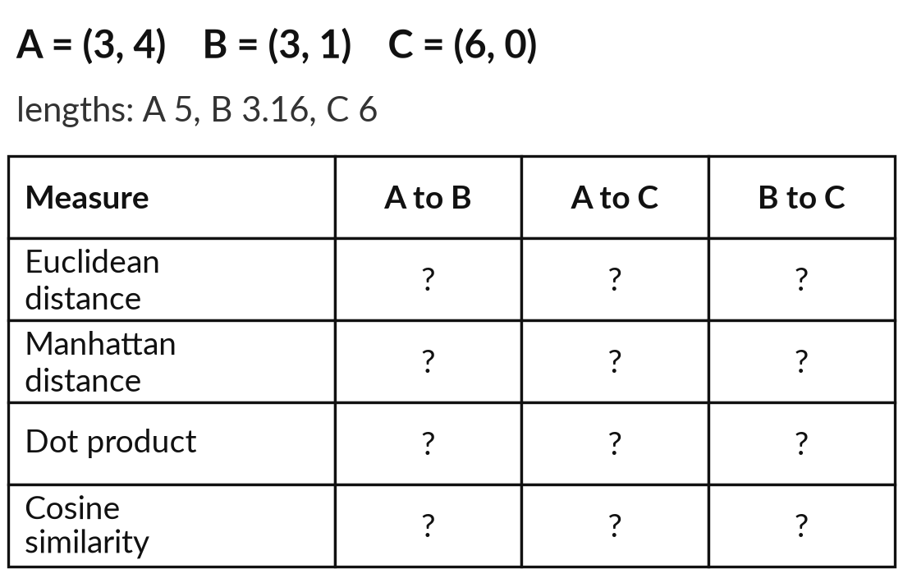
Work out the four measures
by hand for three viewers
15 minutes
Hands-on, no computer
Fill in the table for the three pairs.
Mark A, B and C on squared paper.
Euclidean: √(gap₁² + gap₂²).
Manhattan: |gap₁| + |gap₂|.
Dot product: a₁b₁ + a₂b₂.
Cosine: dot product ÷ (length × length).
You keep: The twelve answers and which pair each measure calls closest.
Notes:
You have seen the ideas and the search, so it is your turn with a pencil. Take fifteen minutes. Three viewers rate Film 1 and Film 2 out of ten: A gives three and four, B gives three and one, C gives six and zero. On squared paper, mark the three points and draw an arrow from the origin to each.
For each pair, work out four numbers using the formulas on the sheet. For Euclidean distance, square each gap, add, take the square root. For Manhattan distance, add the sizes of the gaps. For the dot product, multiply matching ratings and add. For cosine, divide the dot product by the two lengths: A is five, B is three point one six, C is six.
When you have the twelve answers, ask which pair each measure calls closest. They will not all agree.

Slide 25




Where would semantic search
help or hurt in your own work?
Write three plain descriptions of terms you use, then say where searching by meaning would help.
Find by idea
Match near copies
Group by topic
Keep exact search
Clauses, policies or terms you can describe but not name.
Duplicate invoices, supplier or customer names.
Enquiries or complaints sorted by what they are about.
Codes, numbers and names must match exactly.
Three descriptions with predictions, your option, and the cost of a wrong first answer.
Notes:
You have worked the four measures yourself, so now turn the idea on your own work. You have twenty-five minutes, and I walk round. First, pick three formal terms you use, such as a clause or an account name. Write a plain description of each, using none of its words, as if explaining it to a new colleague.
Predict whether a keyword search would find it, and whether a semantic search would. Write yes, no or unsure. Then think of a pile of text you search today and choose one option: find by idea, match near copies, group by topic, or keep exact search, where an invoice number or a legal citation must match exactly.
Say aloud what a wrong first answer would cost you. In the last minutes I run one or two descriptions live on a few short paragraphs of your own text.

Slide 26
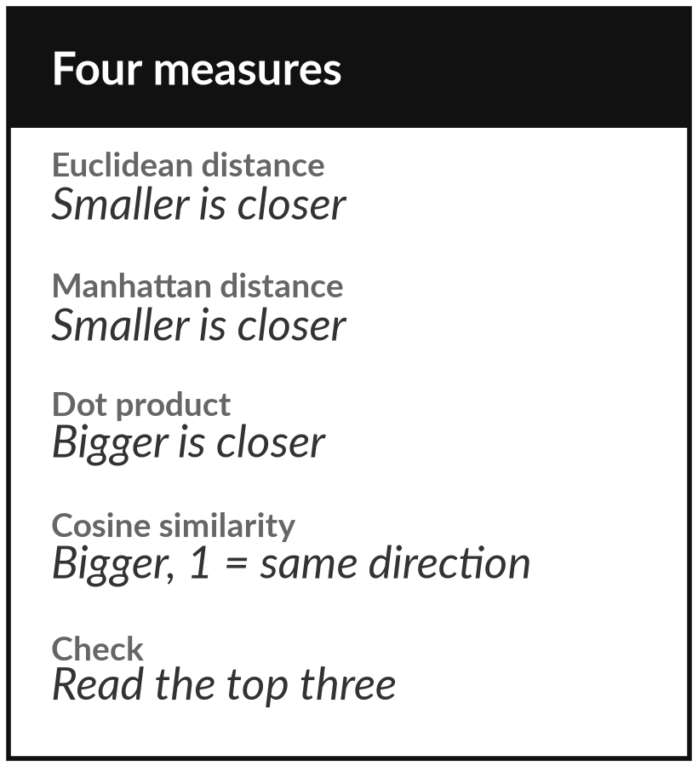
Keep the cheat sheet of the four measures, and
try a plain description on your own documents
What you keep from today
The cheat sheet of the four measures: Euclidean distance, Manhattan distance, dot product and cosine similarity, each with its formula, its picture and when to use it.
Our question today
How can a computer find the right clause or policy when I describe it in plain words?
Next session
Session 5: Language models: tokens, attention and next-word probability. Nothing to prepare.
Notes:
Keep the cheat sheet. It has the four measures, each with its formula, its picture and when to use it. If a vendor says similarity or distance, ask which measure, and whether the vectors were set to length one first. Try it this week: write a plain description of a clause or policy from your own documents and ask yourself whether a keyword search would find it.
That is how a computer reads words: as vectors it can compare. Next time, Session 5, we ask how a language model uses these numbers to write the next token.
We began with this question: How can a computer find the right clause or policy when I describe it in plain words? Before you go, say in one sentence what you can now say about it.

